Slide 1
SBDC Center Analysis Comparisons

Slide 2
Center Number | Center Name | Total Staff | Ideal Staff
1 | Omaha | 5 | 4.9
2 | Lincoln | 1.5 | 2.2
3 | Kearney | 1 | 1.3
4 | Wayne | 1 | 1.6
5 | North Platte | 1 | 1.0
6 | Scottsbluff | 1 | 1.0
7 | Chadron | 1.5 | 1.4
Notes:
This table shows the ideal number of staff members estimated for each center, based on a sensitivity analysis. In this process, small adjustments were made to key factors, like the population, total counseling hours, and the number of clients, to see how these changes would affect the required staffing level. By varying each factor up and down, the model observes the impact on predicted staffing needs, helping refine the final ideal number of staff.
The final "ideal" number for each center in the table is a balance point where the model indicates optimal staff levels, given the specific needs and workload of each location. This approach considers the impact of slight increases or decreases in demand, helping ensure the suggested staffing number is realistic for each center’s needs.

Slide 3
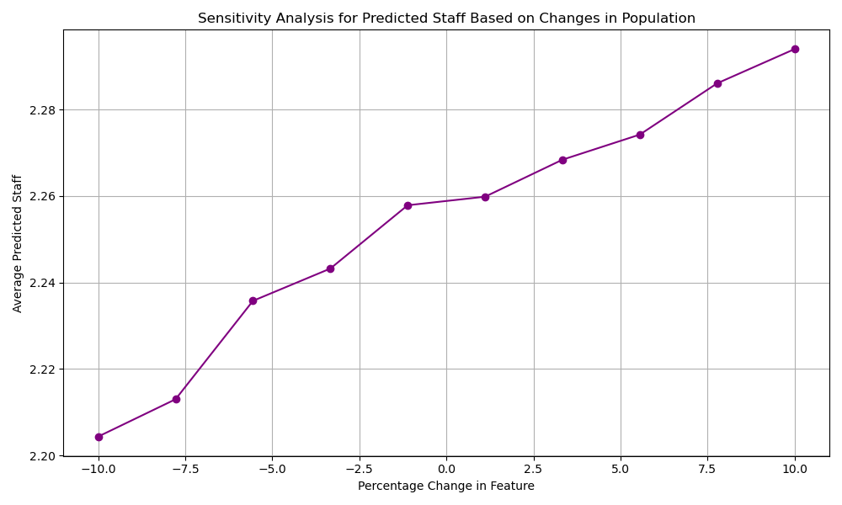
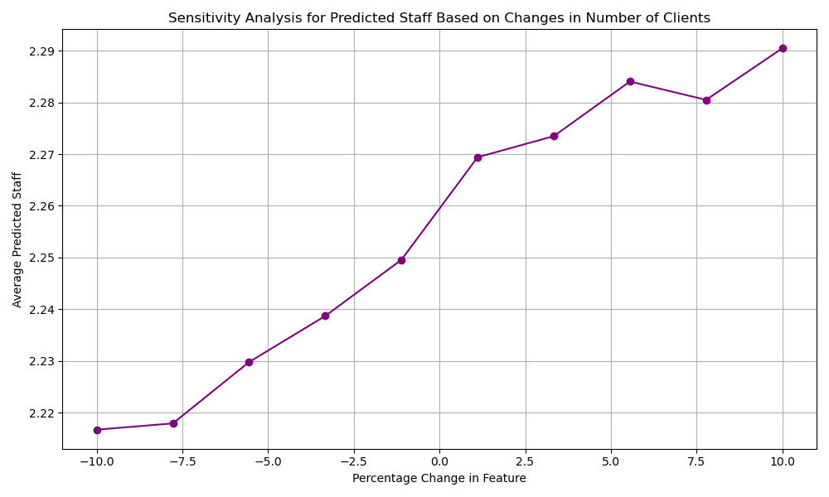
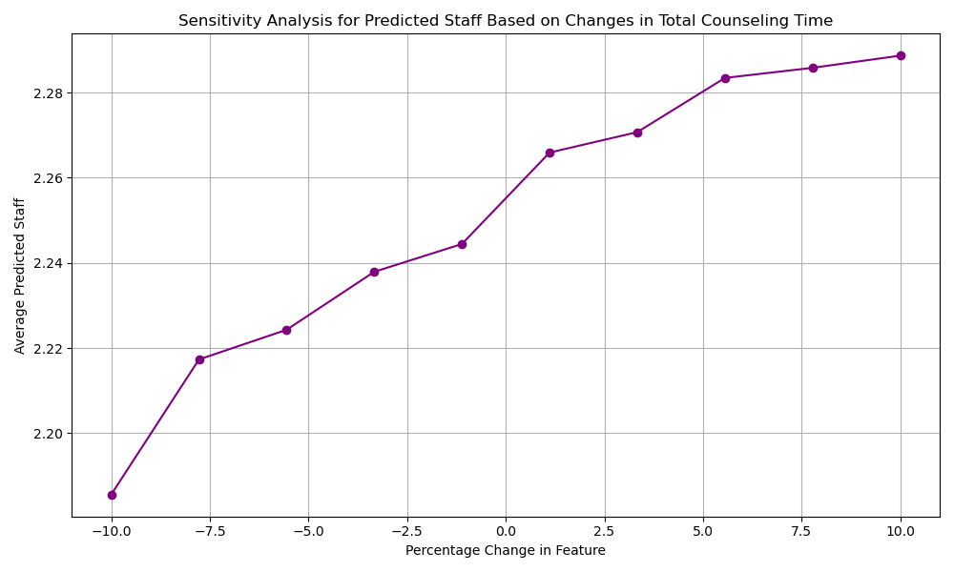
Notes:
In this slide, I included three sensitivity analysis plots—one for each of the key variables: population, number of clients, and total counseling time. These plots illustrate how small adjustments in each factor impact the predicted ideal staffing levels.
For example, in the population plot, the x-axis represents percentage changes in the population value, ranging from a 10% decrease to a 10% increase. The y-axis shows the average predicted staff number for each adjusted population level. A positive slope in the line suggests that as the population increases, the model predicts a higher ideal number of staff members.
Through this analysis, the model essentially trains on these adjustments, testing how increases or decreases in each variable impact the staffing recommendation. Based on its learned relationships, the model refines the estimate of the ideal staff number by responding to these individual changes. This approach provides a more tailored recommendation by considering how each factor individually influences the suggested staffing level.
I used the other variables, but those are the key ones in making that final decision.

Slide 4
Center Number | Center Name | Total Staff | Predicted Counseling Time | Expected Hours per Consultant | Expected Hours per Client
1 | Omaha | 5 | 1,540.4 | 308.1 | 3.6
2 | Lincoln | 1.5 | 919.2 | 612.8 | 8.7
3 | Kearney | 1 | 515.0 | 515.0 | 6.2
4 | Wayne | 1 | 488.5 | 488.5 | 5.7
5 | North Platte | 1 | 140.7 | 140.7 | 3.5
6 | Scottsbluff | 1 | 164.7 | 164.7 | 3.2
7 | Chadron | 1.5 | 215.9 | 144.0 | 7.7
Notes:
In the table, we have the results from a statistical model that predicts the expected counseling hours for each Nebraska center. The model takes into account several factors: total staff, population of the service area, whether the center is urban or rural, presence of HR support, total counseling hours, number of clients, and whether the center director has employees reporting to them.
These predicted values give us a baseline of what each center's counseling hours could look like under current conditions. By comparing actual counseling hours to the predicted values, you can assess each center's efficiency and potential needs for additional staffing or resources.

Slide 5
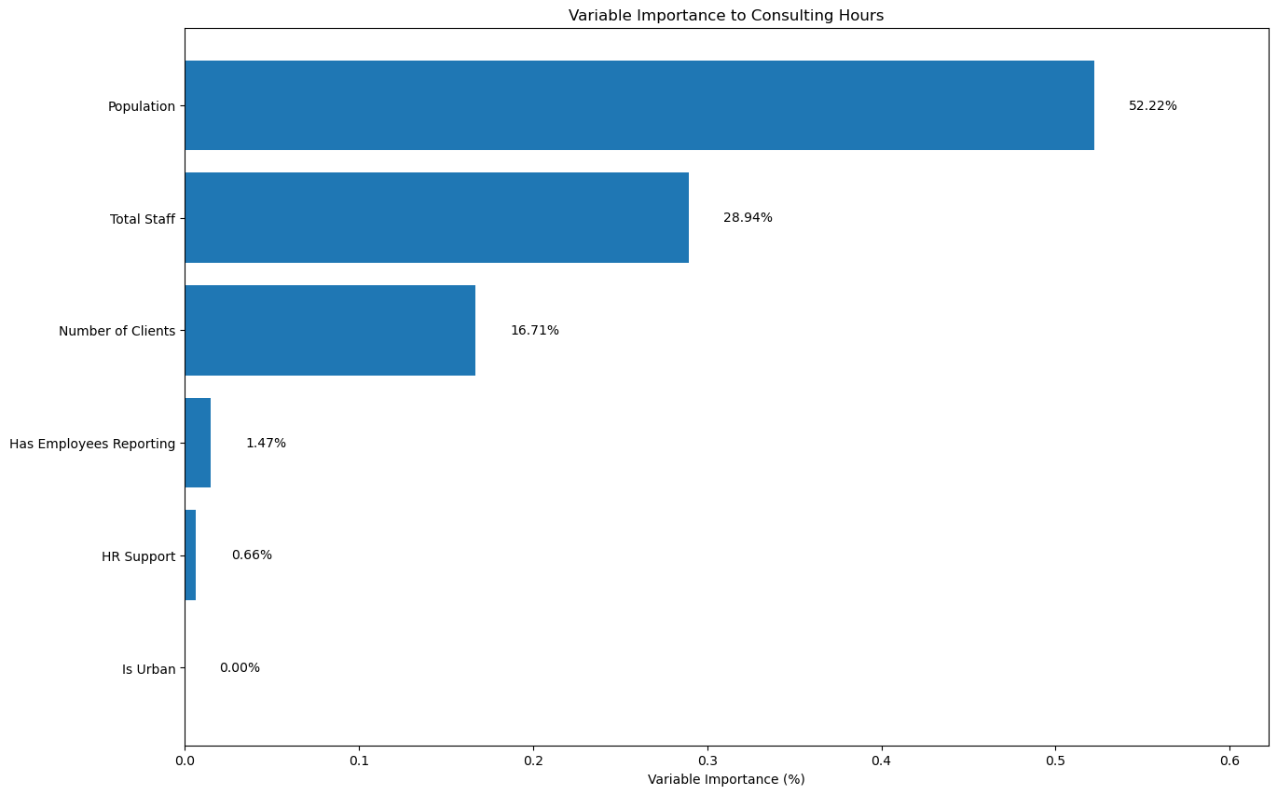
Notes:
This plot displays the relative importance of different factors considered in the model for predicting consulting hours at each center. The model identifies "Population" as the most influential factor, contributing over 50% to the prediction, followed by "Total Staff" and "Number of Clients." These top three factors dominate the model's considerations, while variables like "Has Employees Reporting" and "HR Support" contribute much less to the prediction.

Slide 6
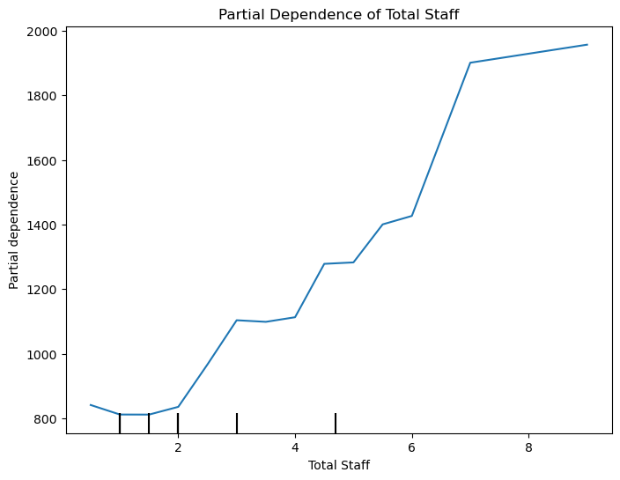
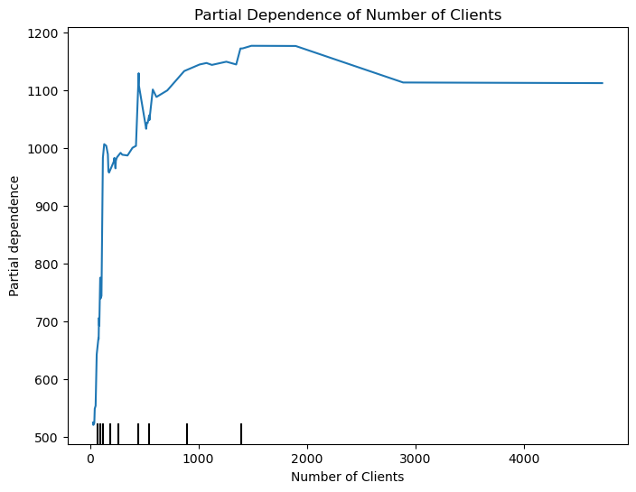
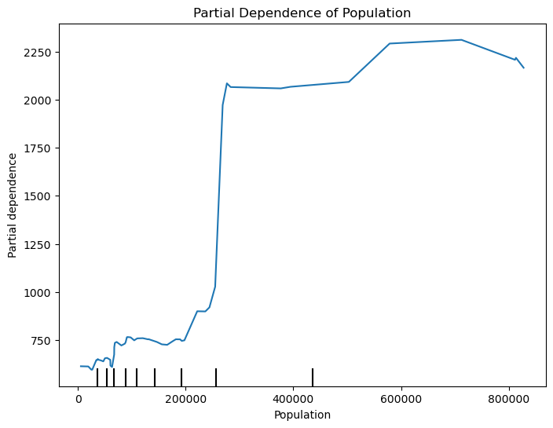
Notes:
These plots illustrate the isolated effect of each variable on the predicted consulting hours by keeping all other factors constant. I included the plots for the most relevant variables, “Total Staff," "Number of Clients," and "Population." The plots show how changes in these specific factors impact the model’s output. This provides insights into each factor's direct influence on consulting hours.
For example, in the plot for "Total Staff," as the number of staff increases, the predicted consulting hours also increase. This trend shows how adding more staff correlates with higher consulting hours, holding all other factors constant.

Slide 7
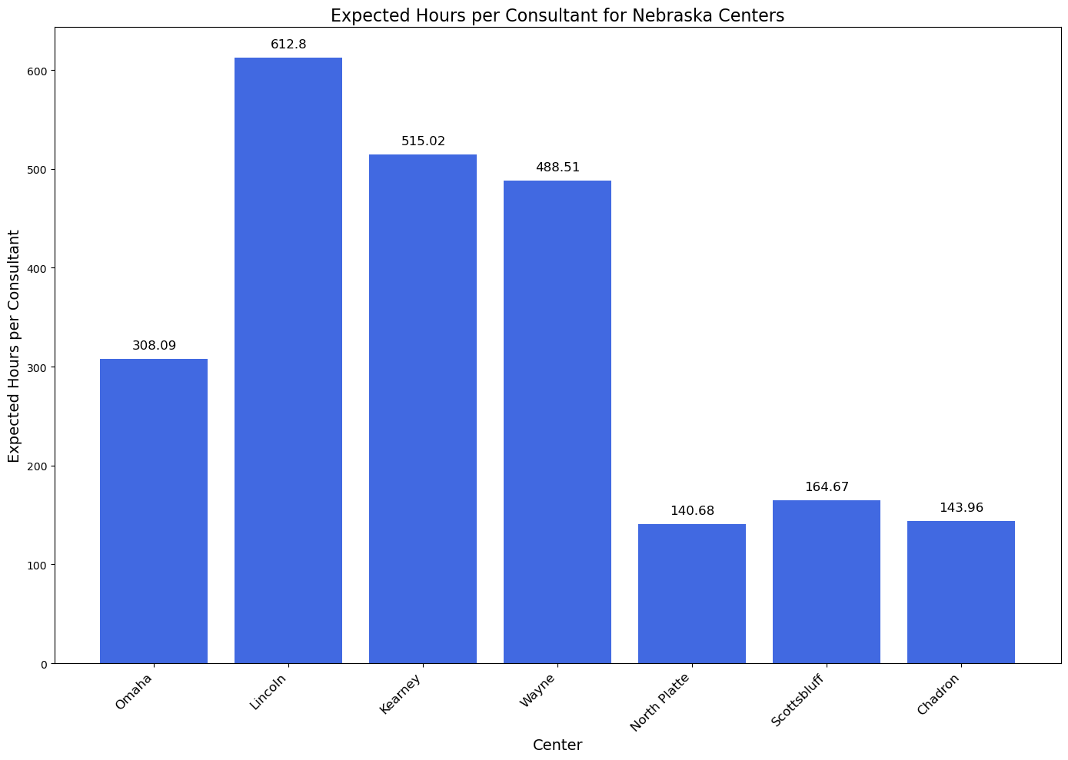

Slide 8
